Slide 1
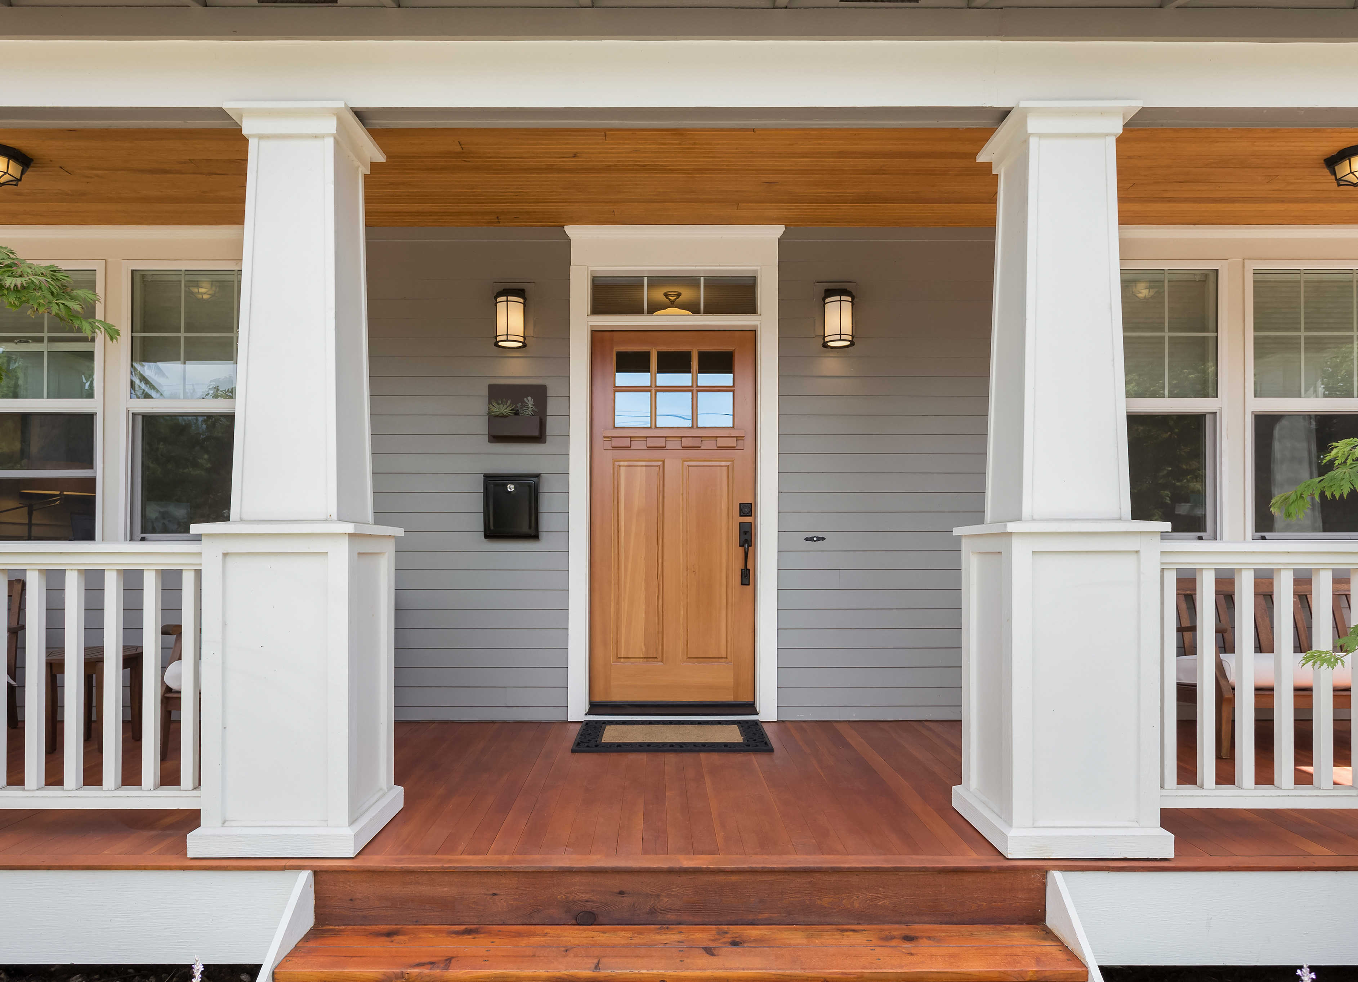
NY MortGaGe TAX STUDY
Team 2 Project #1: Andrea Cereati, Sarah Demmon, Kat McEldowney, Chantal Thomas

Slide 2
AGENDA
1. Define Mortgage Tax
II. Low Income vs High Income vs Greedy Investor Scenarios
Hypothesis
Method Step By Step
Data and Insights
Proposal
Low Income vs High Income vs Greedy Investor Revised
Total Estimated Revenue Generated (New!)
GitHub Repository Requirements
Data (CSVs)
PDF
Jupyter Notebook
Readme

Slide 3
Only 7 States have a mortgage tax
Alabama, Florida, Kansas, Minnesota, New York, Oklahoma and Tennessee

Slide 4
What ARE THE home Purchase TAXES IN NY? When buying a home, New York imposes a mortgage tax on the amount you borrow
Mortgage Tax
The tax rate in NY is 1.8% on mortgaged amounts <$500,000 and 1.95% on mortgages >$500,000.
*Paid upfront at closing
Mansion Tax $$$$
There is only a sales tax on homes > $1,000,000 and this amount is only 1%
*Paid upfront at closing
Ubiquitous Sales Tax
?

Slide 5


HOW DO These Taxes WORK?
Lower Income
Higher Income
Susan, 30 yrs old, earns $55K
Matthew, 37 yrs old, earns $200K
Home Purchase Price: $625,000
Down Payment: $18,750 (3%)
Mortgaged Amount: $606,250 (above $500K)
Mortgage Tax (1.95%): $11,821.87
Home Purchase Price: $625,000
Down Payment: $156,000 (25%)
Mortgaged Amount: $468,000 (under $500K)
Mortgage Tax (1.8%): $8,424

Slide 6

Investor Scenario
John, 50 yrs old, kingpin investor
Matthew, 37 yrs old, earns $200K
Susan, 30 yrs old, earns $55K
Home Purchase Price: $625,000
Down Payment: $625,000 (100%)
Mortgaged Amount: $0
Mortgage Tax: $-
Home Purchase Price: $625,000
Down Payment: $18,750 (3%)
Mortgaged Amount: $606,250 (above $500K)
Mortgage Tax (1.95%): $11,821.87
Home Purchase Price: $625,000
Down Payment: $156,000 (25%)
Mortgaged Amount: $468,000 (under $500K)
Mortgage Tax (1.8%): $8,424

Slide 7
HYpothesis

Slide 8
OUR HYPOTHESIS
We believe that if the mortgage tax was lowered, applied across the board, and based on sales price (not the mortgage amount) for all home purchases, it would raise MORE REVENUE for the government.
2022 Estimated Home Purchase Tax Revenue Raised in Brooklyn: $
We also believe that the mortgage tax is an unfair tax that has a disproportionate impact on people with lower incomes (essentially those that borrow large sums to purchase a home).

Slide 9
The METHOD

Slide 10
APPROACH
We analyzed 2022 sales data of 15,550 homes sold in Brooklyn, NY zip codes. We then segmented the data into two groups – the top and bottom income zip codes outside of the borough
We calculated how much Mortgage tax was raised in Brooklyn. We calculated how much Mansion tax was raised in Brooklyn
We calculated how much would be raised if there was a sales tax that was only 50% of the current Mortgage tax rate and if the Mansion tax was cut in half at 0.5% instead of the current 1%
We used census data to examine the differences in demographics of the different zip codes to see if people with lower incomes are paying a large portion of this tax than people living in zip codes with higher average incomes.
Step 1
Step 2
Step 3
Step 4

Slide 11
The DATA

Slide 12
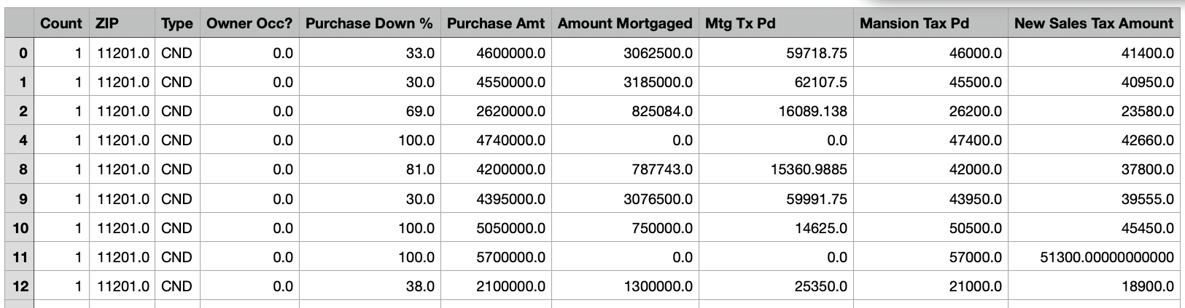
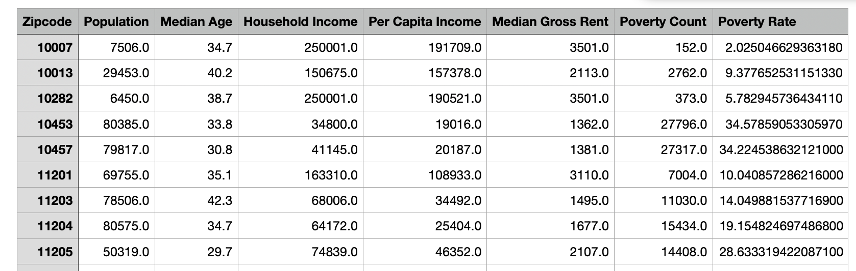
Our Datasets
2022 real estate sales transactional data for Brooklyn NY only
Home Sales broken down by:
Zip, Home Type, Address, Purchase Amount, Purchase Down %, CLTV%, Owner Occupy (y/n), Listed for Sale, Purchase Date, Mortgage Tax Paid, Mansion Tax Paid
Census Bureau API Data
Census data fields:
Zip, Population, Median Age, Household Income, Per Capita Income, Median Gross Rent, Poverty Count, Poverty Rate

Slide 13
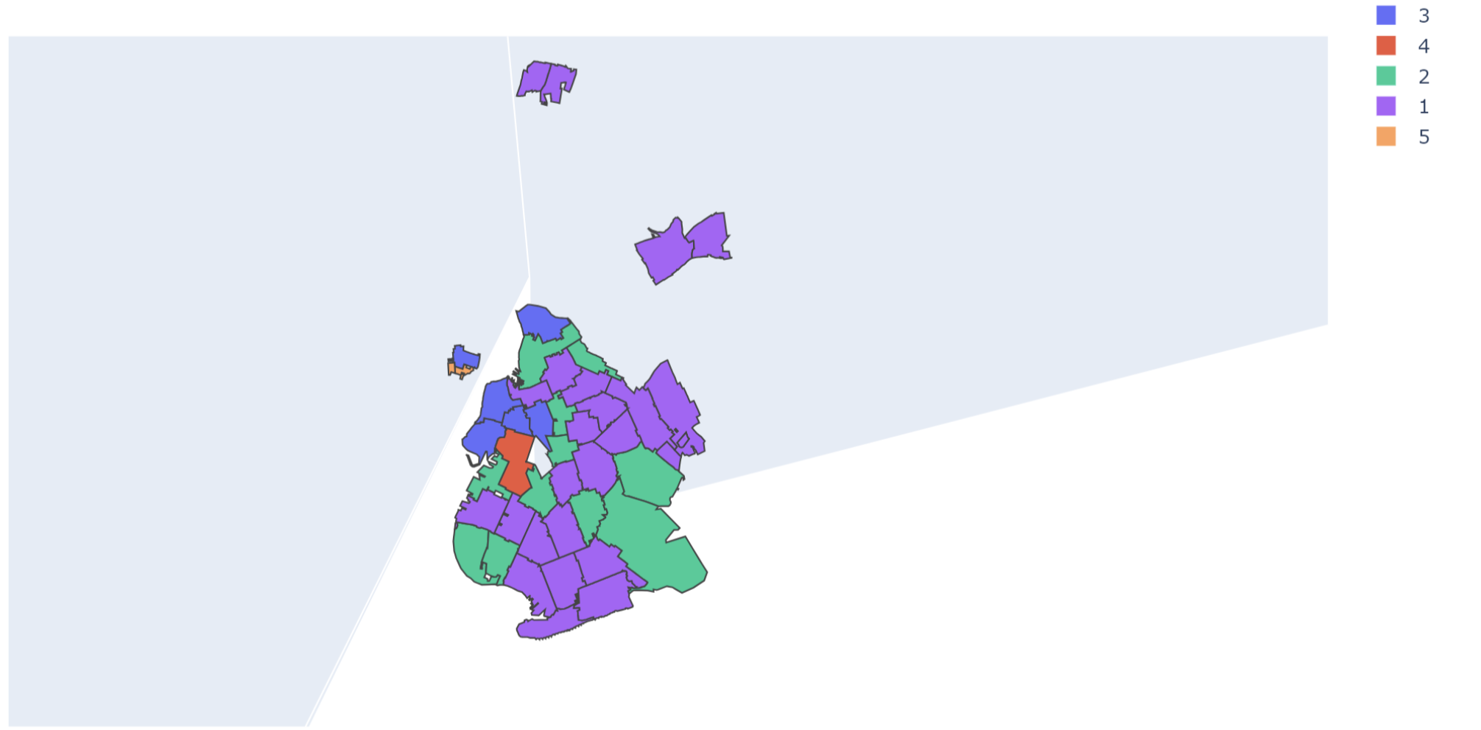
Coverage Area Sorted By Income
Brooklyn NY Area Map w/ Income
Bottom 20% Income
Top 20% Income
Income Ranges
Top 20%:
Bottom 20%:

Slide 14
What percent of income is devoted to mortgage tax?
AVERAGE MEDIAN INCOME

Slide 15
AVERAGE MEDIAN INCOME

Slide 16
What percent of income is devoted to mortgage tax?
AVERAGE MEDIAN INCOME

Slide 17
Proposal

Slide 18
PROPOSED New TAxES
Step 1
We analyzed 2022 sales data of 15,550 homes sold in Brooklyn, NY zip codes. We segmented the data into two groups – the top and bottom performers – for a subset of zip codes
We calculated how much Mortgage tax was raised in Brooklyn. We calculated how much Mansion tax was raised in Brooklyn
Step 3: Then, we calculated how much would be raised if there was a sales tax that was only 50% of the current Mortgage tax rate and if the Mansion tax was only an additional 0.5% instead of the current 1% (since those purchasing homes over a million dollars would now also be paying the standard sales tax).
Step 4: We used census data to examine the differences in demographics of the different zip codes to see if people with lower incomes are paying a large portion of this tax than people living in zip codes with higher average incomes.
Step 2
Step 3

